Slide 1
SWMMR
EHSAN UL HOQUE TANIM

Slide 2
ABOUT SWMMR
Storm Water Management Model (SWMM) is used to analyze, design or optimize urban drainage systems. R package SWMMR does the same with advanced analysis and visualizations of model data.
Contains functions to read and write SWMM files, initiate simulations and convert files to GIS data.
Useful to assist the modeler during the modeling process
Package relies on tidyverse package
Functions included: read_inp(), read_rpt(), read_lid_rpt

Slide 3


AUTHOR
Author: Dominik Leutnant, Anneke Doering, Malte Henrichs, Hauke Sonnenberg
Maintainer: Dominik Leutnant
Dominik Leutnant
Phd in civil engineering
Works at Institute for infrastructure – water – resources – environment (iwaru)

Slide 4


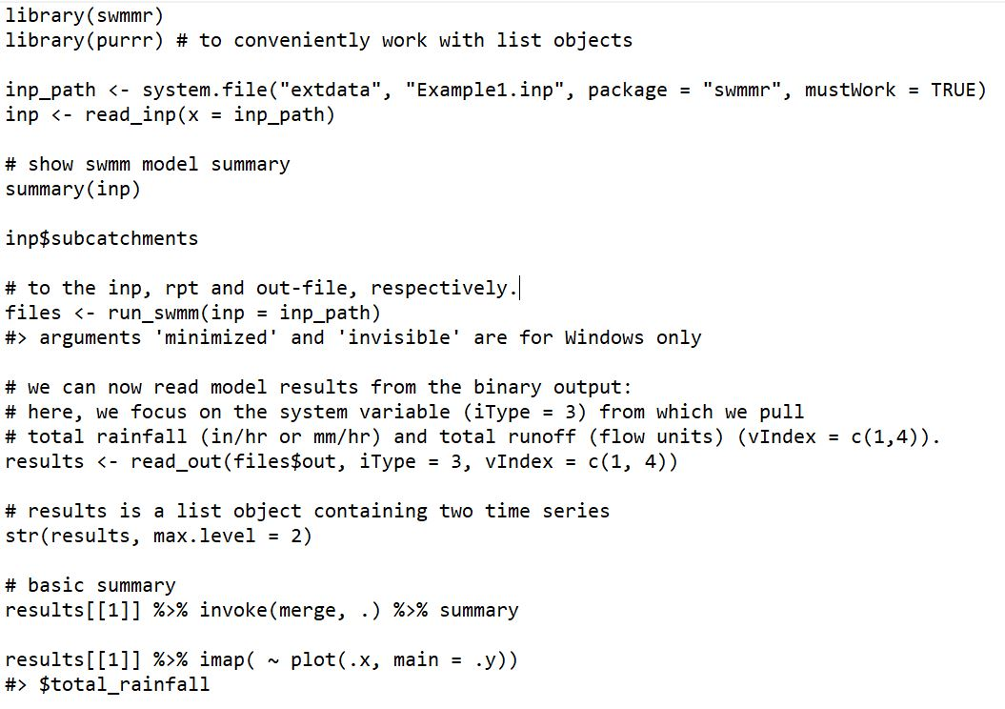
EXAMPLE

Slide 5
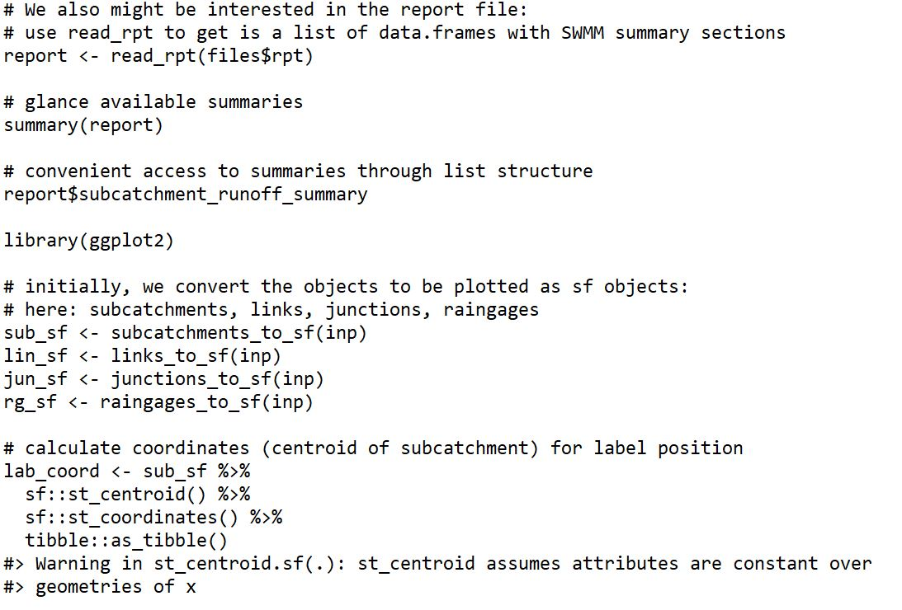
EXAMPLE

Slide 6
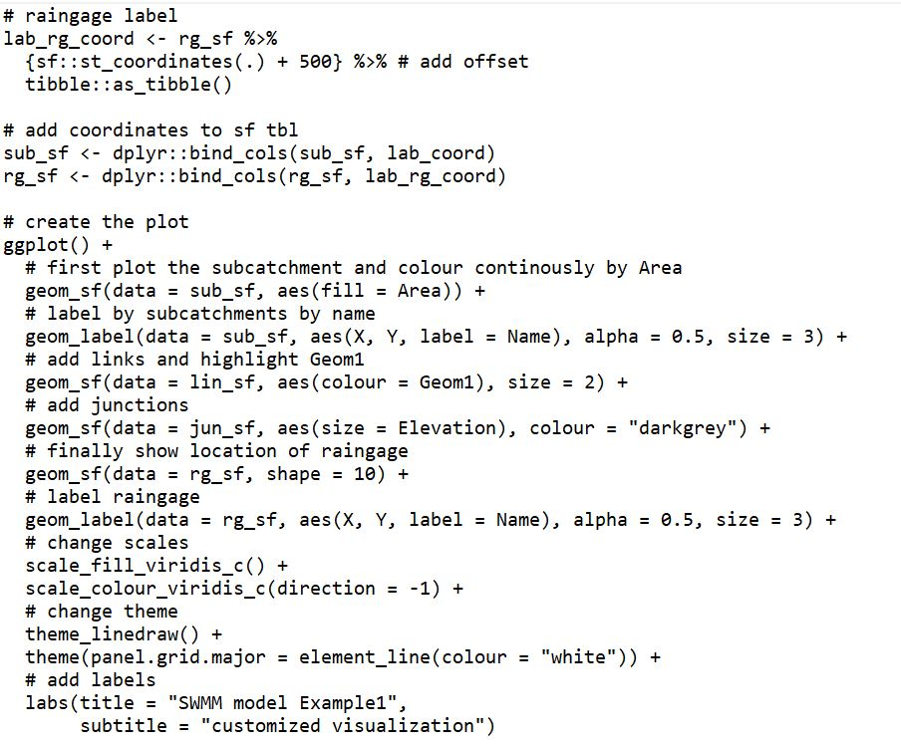
EXAMPLE

Slide 7
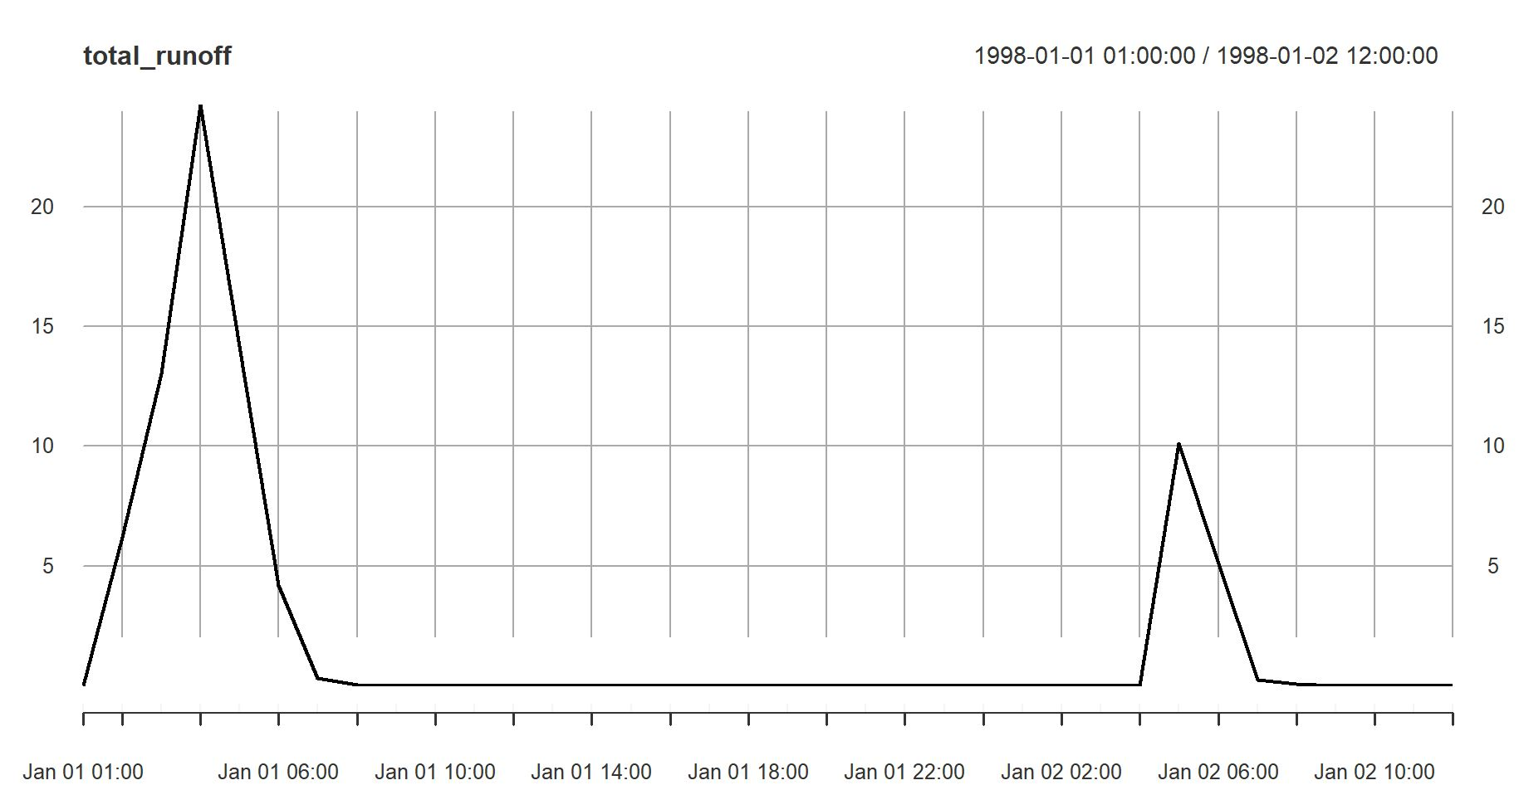
EXAMPLE

Slide 8
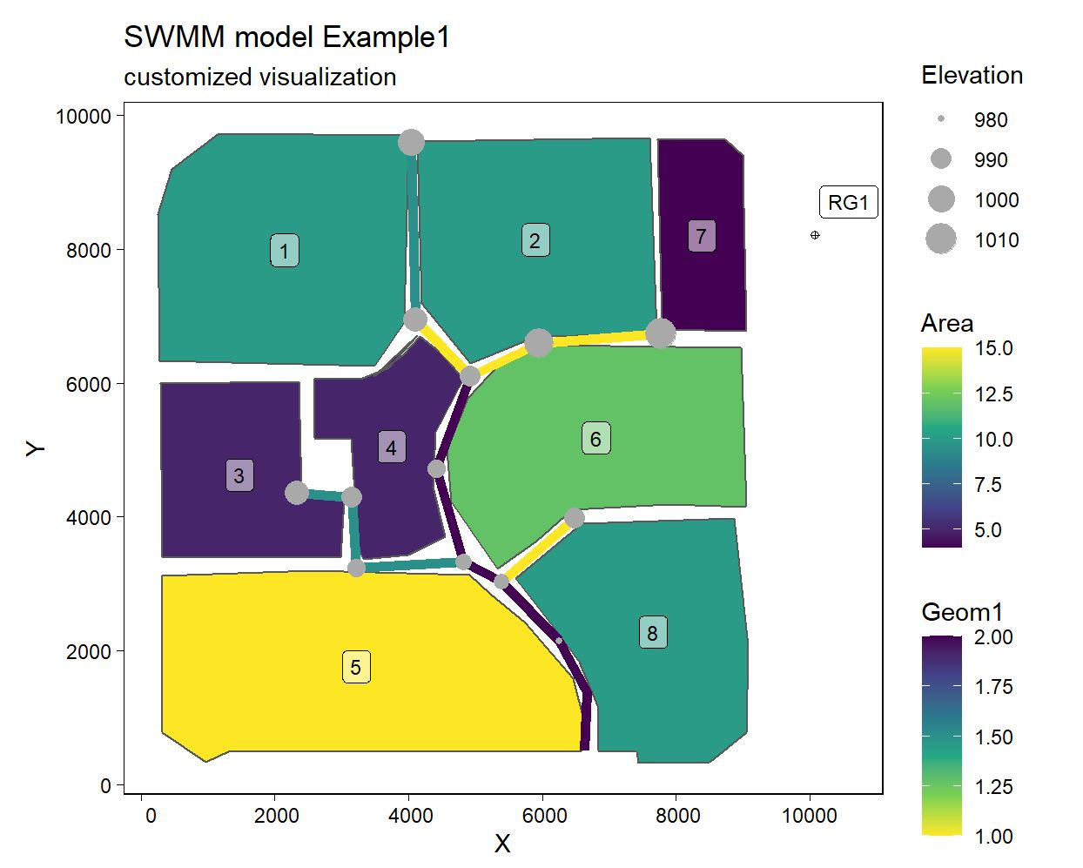
EXAMPLE

Slide 9
references
https://doi.org/10.1080/1573062X.2019.1611889
How swmmr reads and writes SWMM files (microsoft.com)
CRAN - Package swmmr (r-project.org)

